Slide 1
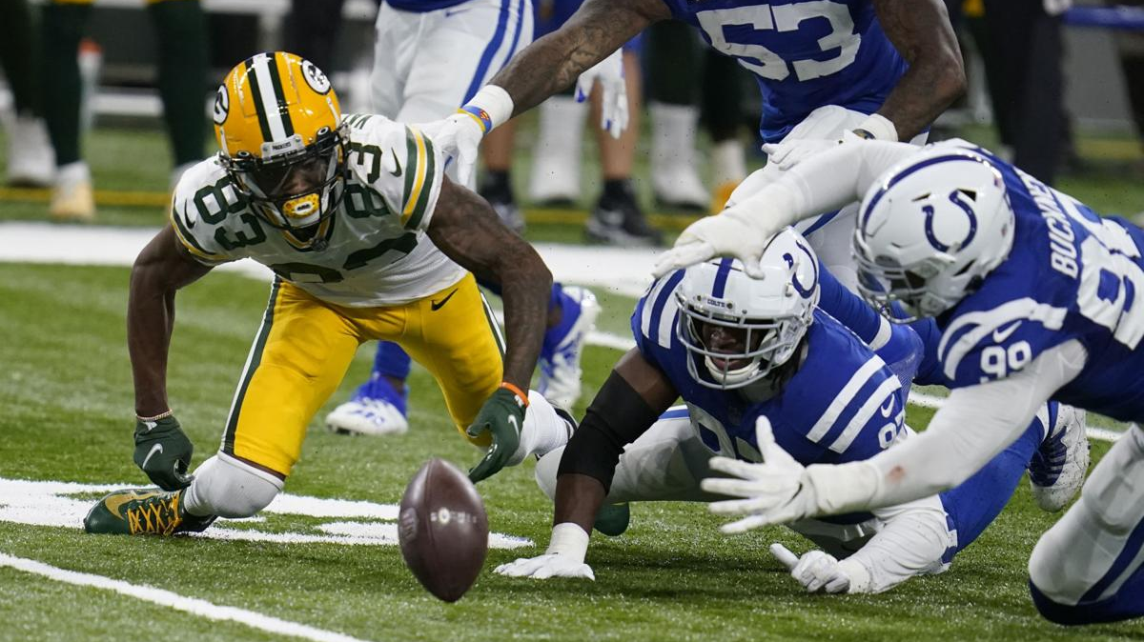
FUMBLE MECHANICS

Slide 2
FUMBLE OBSERVED-BEAN BAG OUT TO MARK THE SPOT WHERE POSSESSION WAS LOST

Slide 3
FIRST OFFICIAL DIGS TO FIND THE BALL, SECOND MAN IN STOPS THE CLOCK

Slide 4
Once ball possession is established cue Ref by the color and make sure he is pointing the right way and giving the proper down signal

Slide 5
Ref is one would be on you all the way. Did the ball come out backwards-fumble, did it come out backwards and get booted forward-fumble, thrown forward incomplete-this can happen on any play

Slide 6
When a loose ball occurs any player may push or pull to get to a live ball that they can possess, so hold up on a flag.

Slide 7
Players can push or pull but can not; hold-take down or tackle a player trying to recover the ball

Slide 8
Fumble in the End Zone, could be a safety or a touchdown. Special awareness.

Slide 9
If a flag hits the ground, much to consider; when did the foul occur during loose ball, the bean bag spot is crucial, was it after possession was established and during a return or where was it in relation to team possession.

